Slide 1

Job Management System(JMS)
Course Code:CSE-3204
Course Title:Software Development Sessional 111
NORTH WESTERN UNIVERSITY,KHULNA

Slide 2



Team Name:..............................................................
NWU_JMS
Details Of The team Mamber...................................
Sadman Hossain
Student ID:20201143010
ariana shuchi
Student ID:20201121010
Sumon Farazi
Student ID:20201117010
1

Slide 3
Presentation Overview
Introduction
Objectives
Entity relationship diagram
Site tree
Description
Home Mode
Candidate Mode
Job Holder Mode
Dependency
Conclusion
2

Slide 4
Introduction
Job Management System is a software developed by python using tkinter
It is developed to module to handle the function of job management system
It is a process where a job holder offers job and find candidate and candidates shows up there qualification to find a perfect job.
This system will be a easier way for A job candidate and job holder.
3

Slide 5
Objectives
To eliminate the paper work in the page.
Simplify find job and find candidates.
build Digital job management infrastructure.
To find a perfect job easily.
To find qualified candidate easily.
4

Slide 6
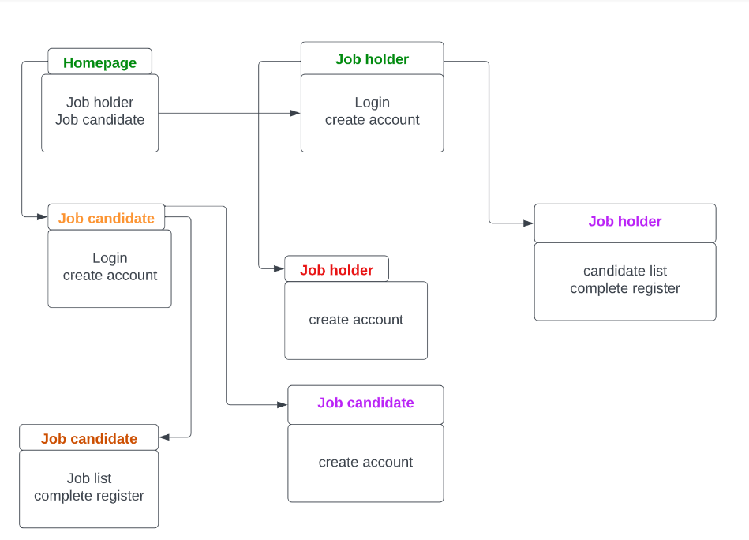
Entity relationship diagram
Figure: E-R Diagram of JMS
5

Slide 7
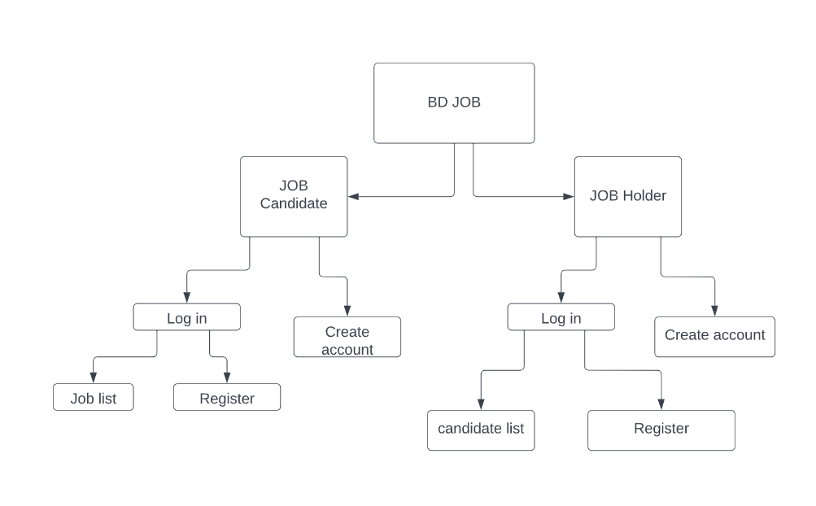
Site Tree
In the Job Management System, there are two characters.
Job holder and job candidate. Each has a unique view and their own Feature. A simple site tree can show
what this character can view.
6

Slide 8
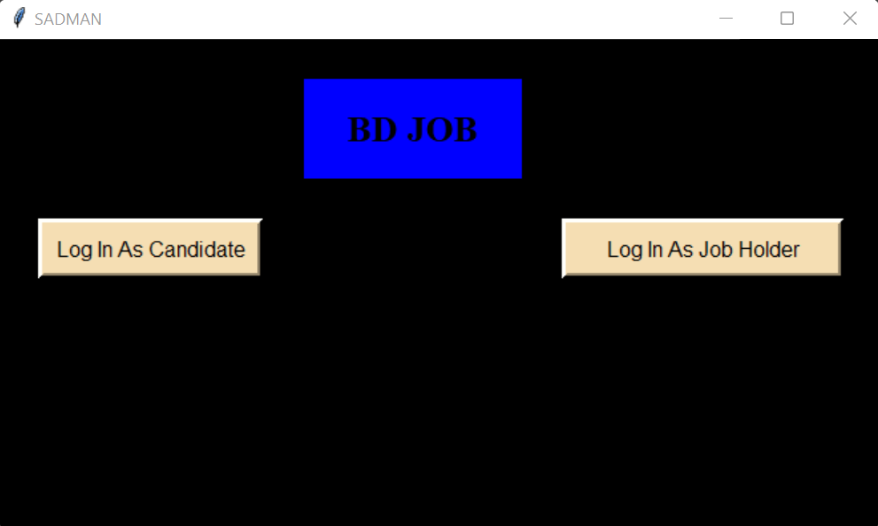
Description
Home Page
Home Page
Candidate button
Job Holder Button
7

Slide 9
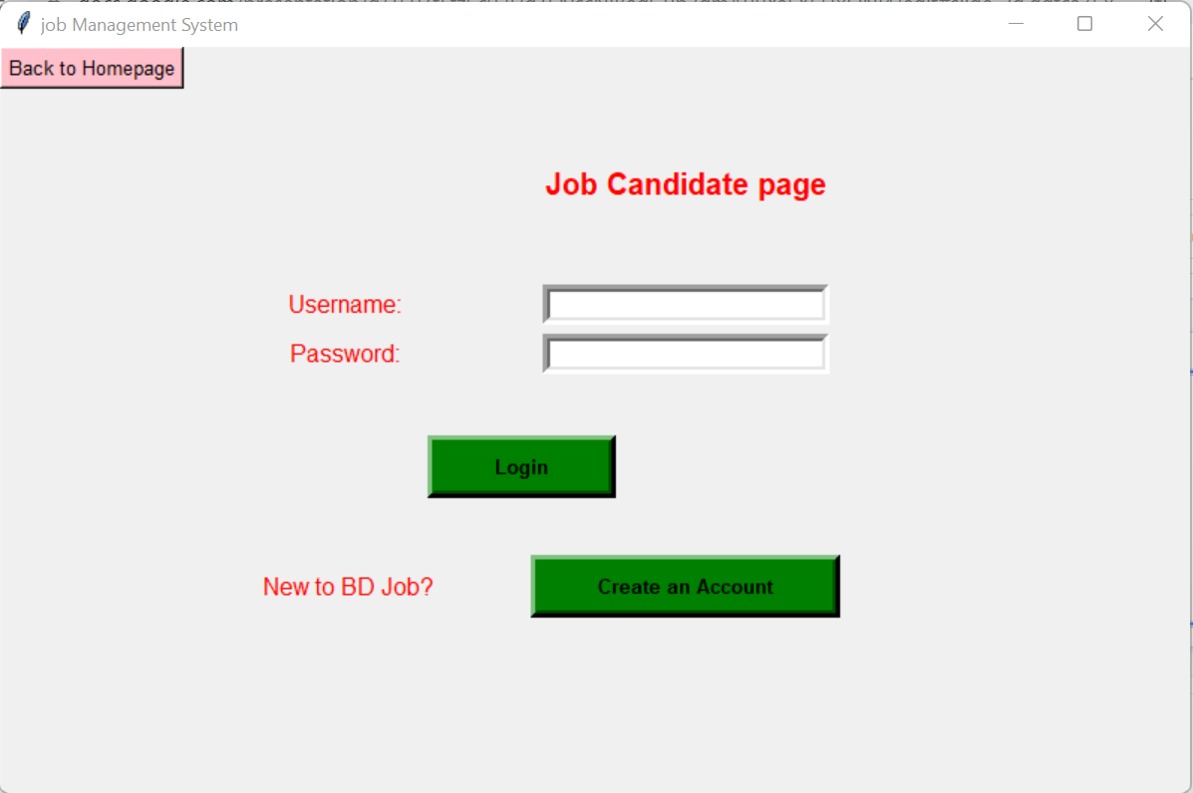
Candidate
After pressing a candidate button
Candidates login
Candidate Create Account
8

Slide 10
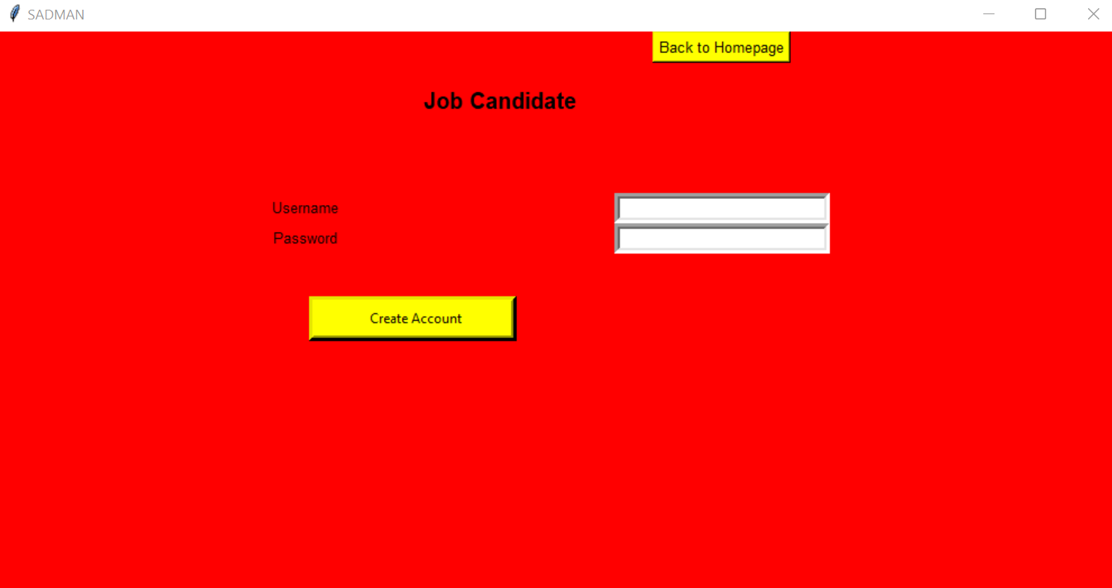
Username
password
9

Slide 11
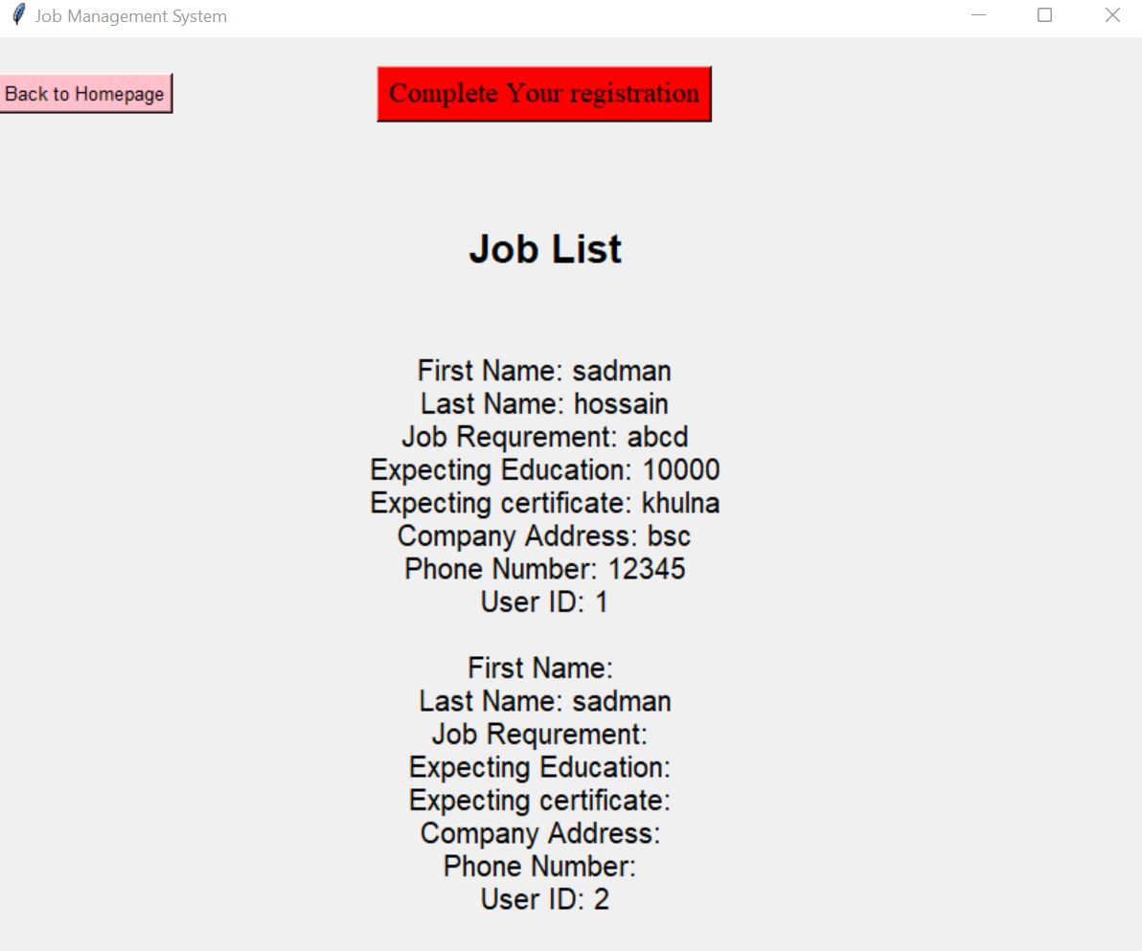
After login show job list
And complete Register button
10

Slide 12
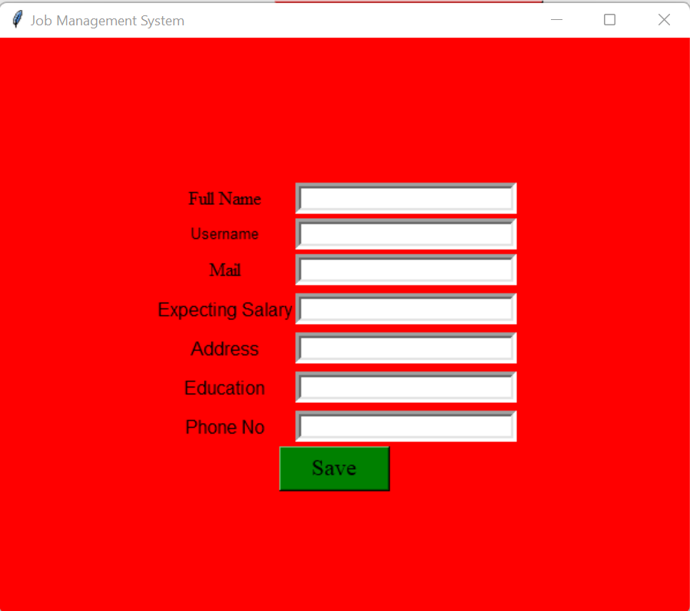
Put information
11

Slide 13
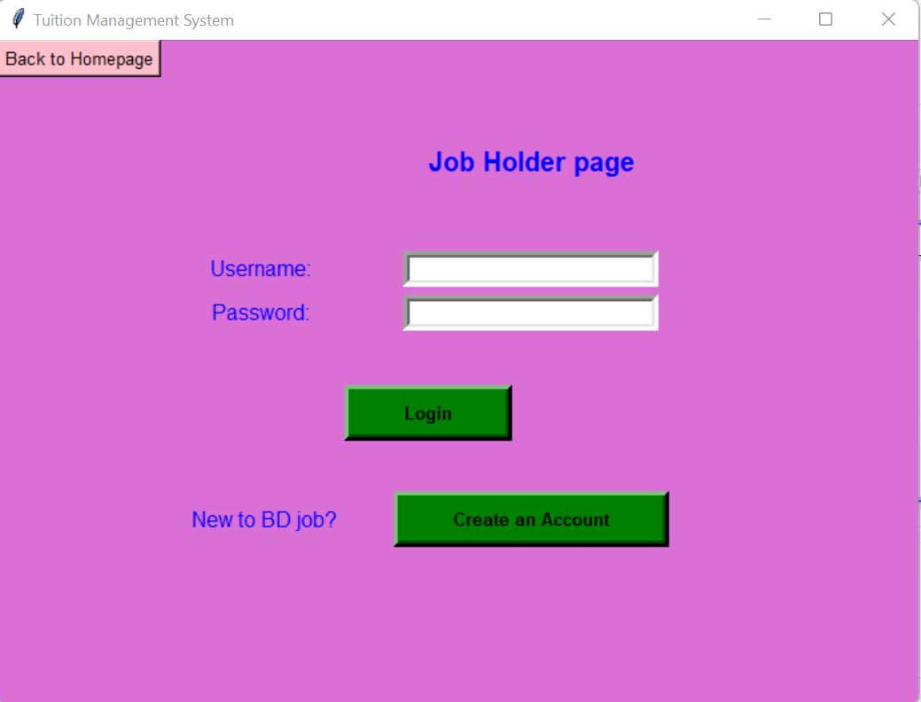
After pressing Job Holder button
Job Holder login
Job Holder Create Account
Job Holder
12

Slide 14
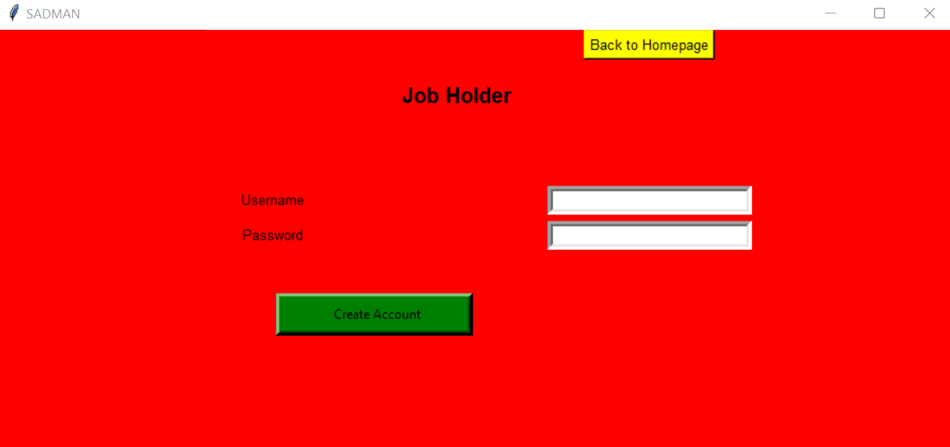
Username
password
13

Slide 15
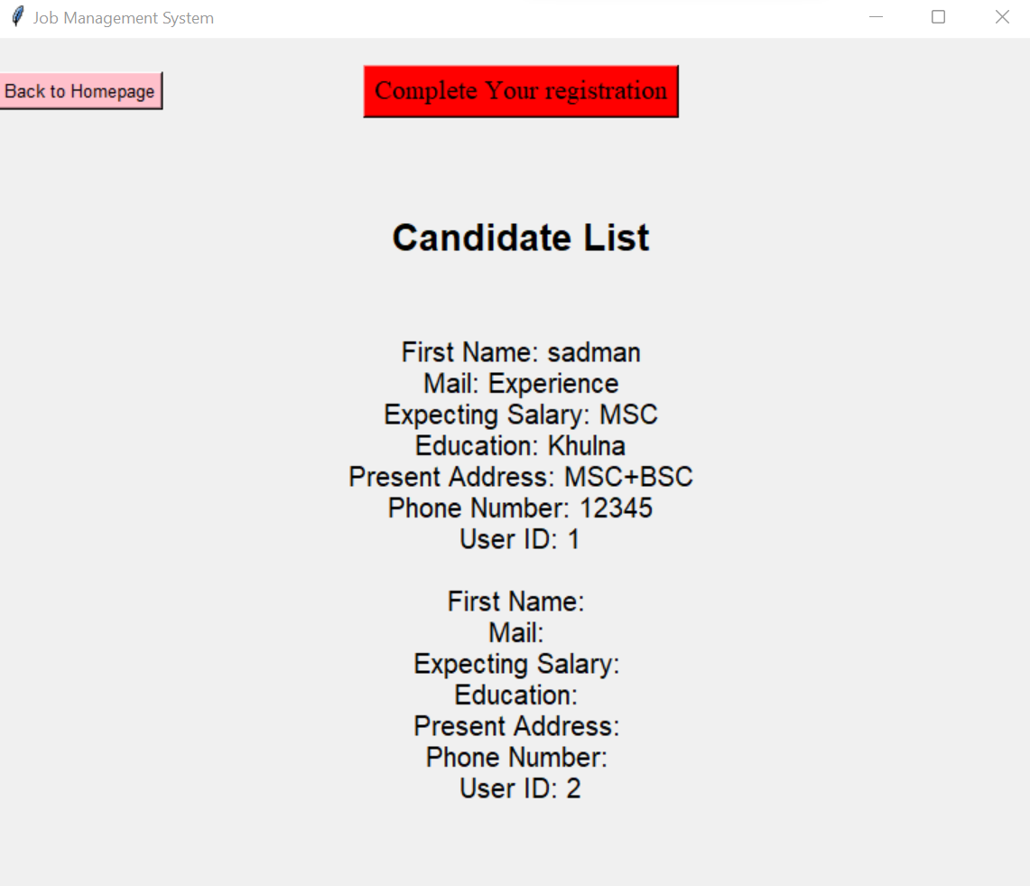
After login show candidate list
And complete Register button
14

Slide 16
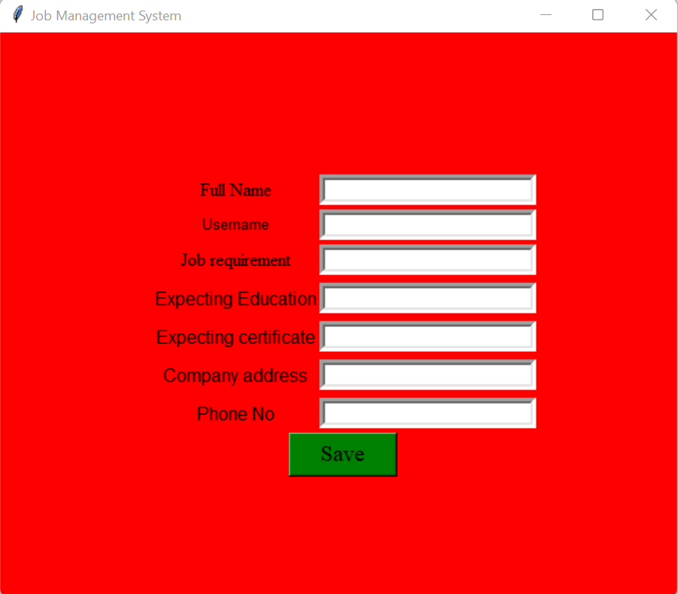
Put information
15

Slide 17
Dependency
Pycharm: For built this project we use Python language and Python Built in
Packages. Install all the Packages which we have use. The name of the
packages are given into ReadeMe.txt file. After Install all packages the project
will run successfully.
Tkinter: We have used Python Tkinter Module for the User Interface. So, you
must have to import the Tkinter Module for successfully executing this project
16

Slide 18
Conclusion
In this digital time this system will be very helpful to people
Every body can easily use this system and can enjoy the features of the system
Every job holder can find required candidate and candidate also will able to find expectable job with expected salary
17

Slide 19
Thank You

